Slide 1
FRIENDS OF AGRIBUSINESS MANAGEMENT AND ENTREPRENEURSHIP INSTITUTE (FAME)
POLLY TOM FAME Farm and Institute

Slide 2
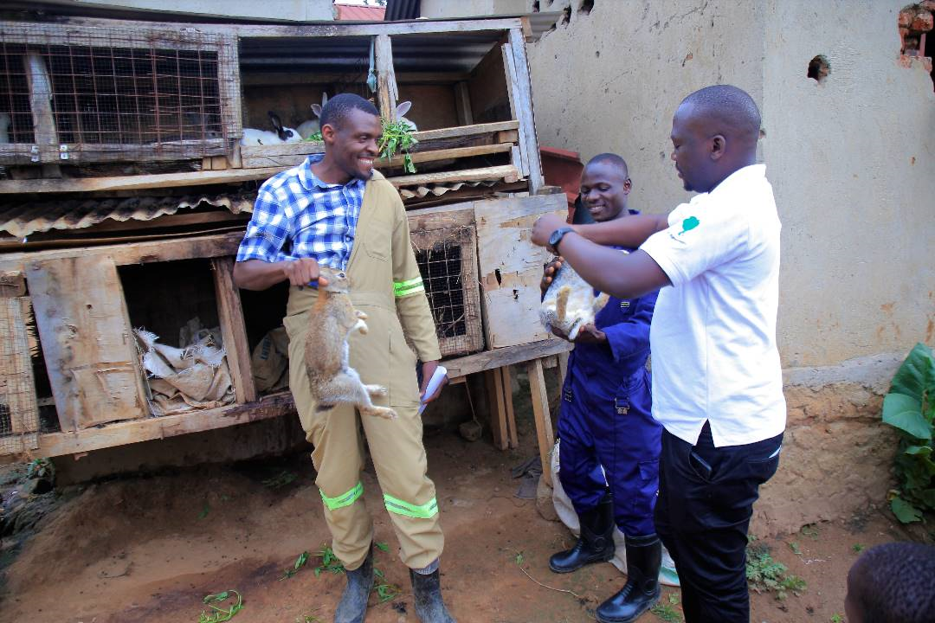
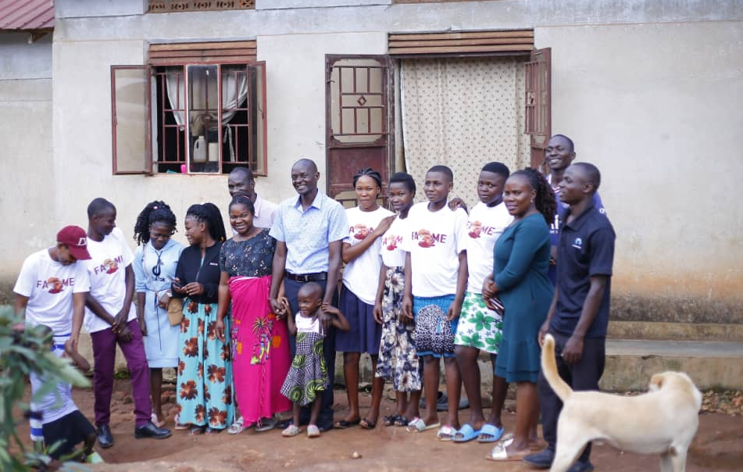

Slide 3
FAME began as CBO in 2014, registered 2019. We have been involved in equipping the youth with skills through schools and community programmmes. we have been exploring the answers to high rates of unemployment, testing numerous ways to ensure that the youth acquire market demanded skills which can help them develop their entrepreneurial abilities thus a self supporting youth.

Slide 4
Our Vision
A developed and self-reliant youth with improved skills, stabilized and sustainable livelihoods in Uganda
Our Mission
To develop a youth holistically for future sustainable improvement that support solutions for household economic growth and Community empowerment in Uganda

Slide 5
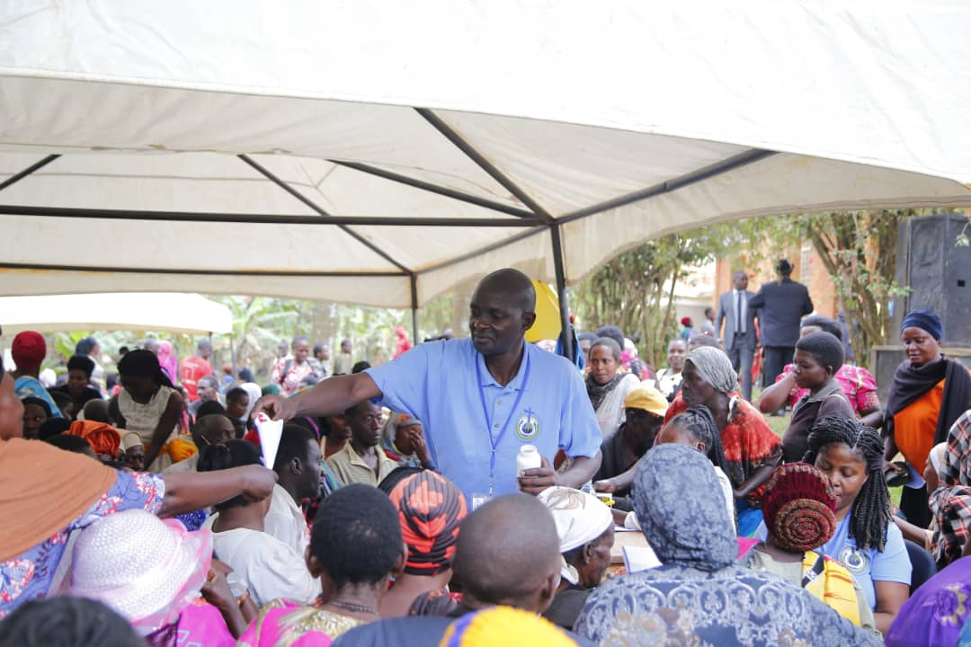
Community outreach

Slide 6
Objectives
Equipping the youth with 21st century skillsets.
Improving entrepreneurial mentality of the youth through apprenticeship.
Improving food security and nutrition of the youth and communities we work in.

Slide 7
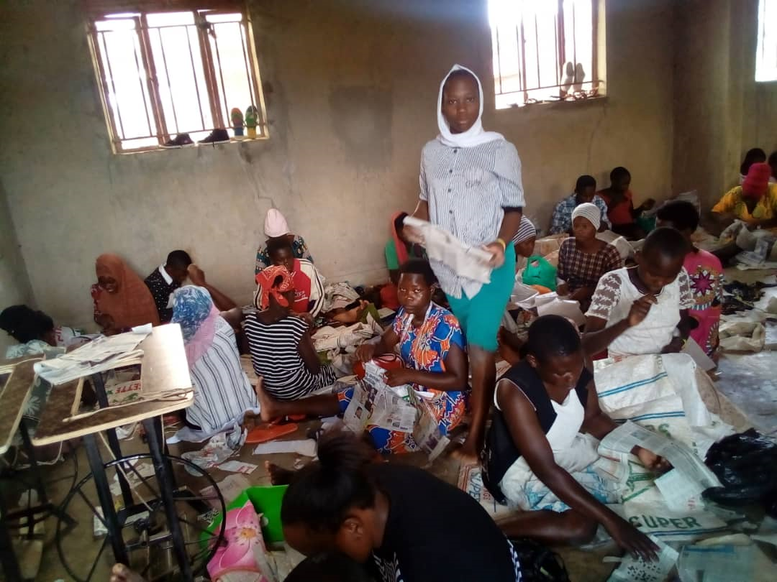
Skilling of the Youth, and Single mothers in Crafts making and Tailoring

Slide 8
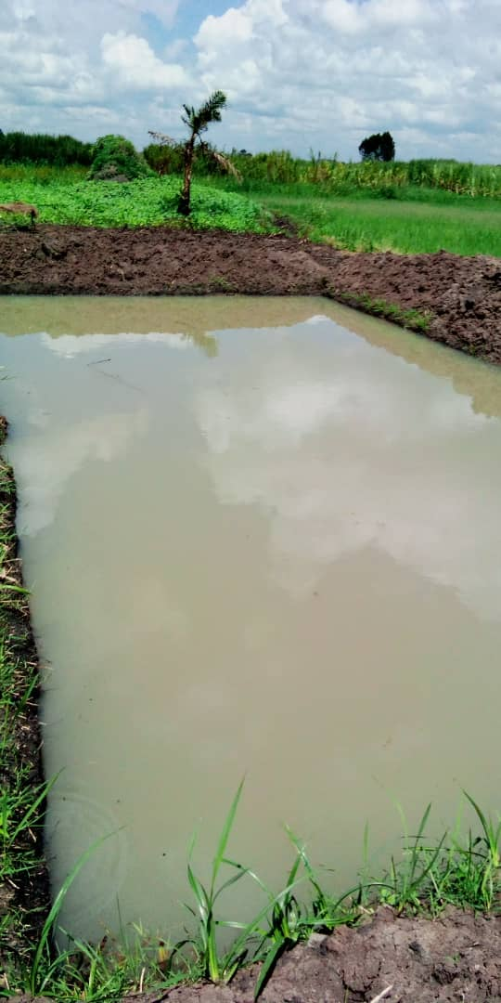
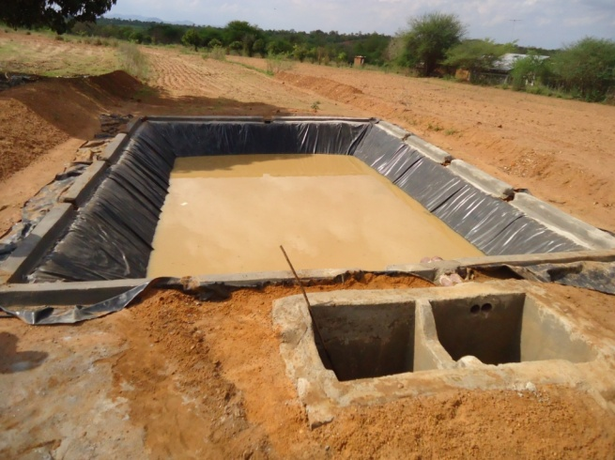
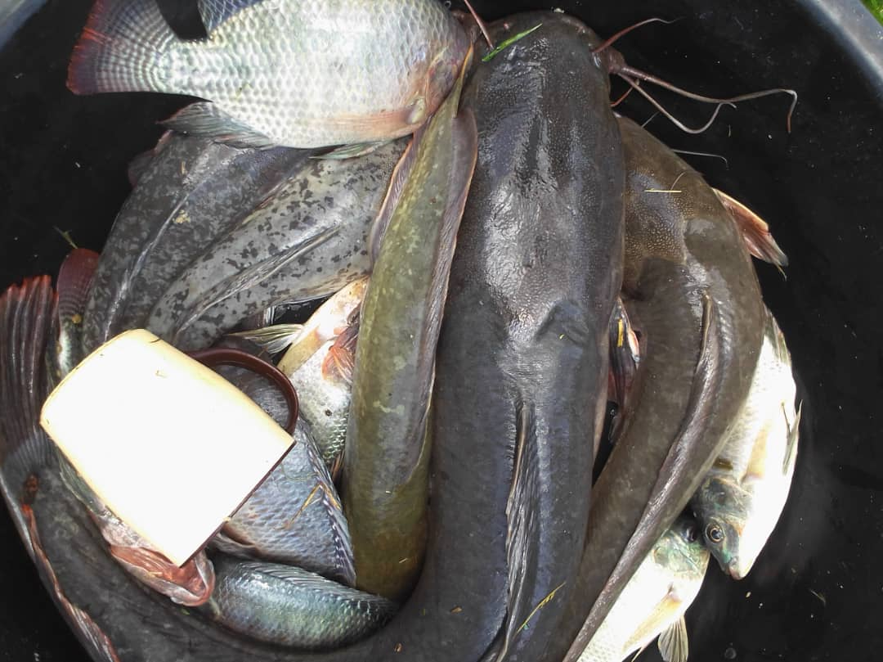
Fish Farming and Management

Slide 9
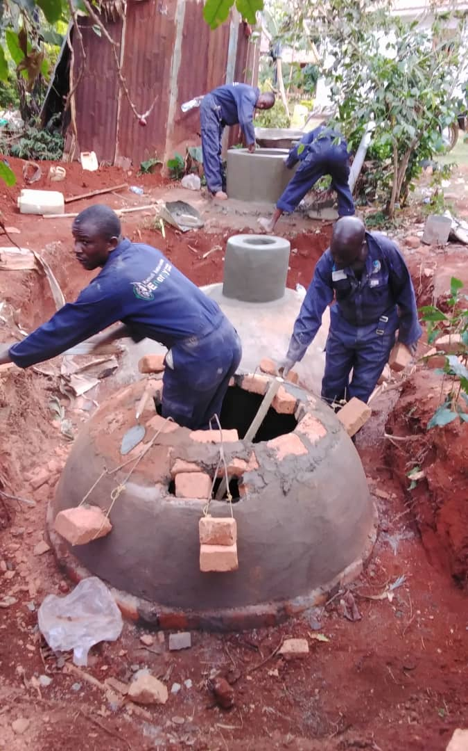
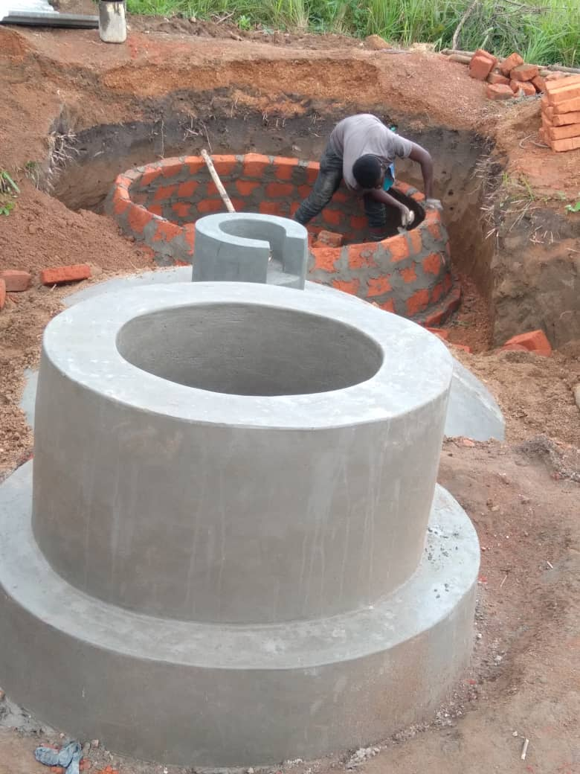
BIOGAS SYSTEM SETUP

Slide 10
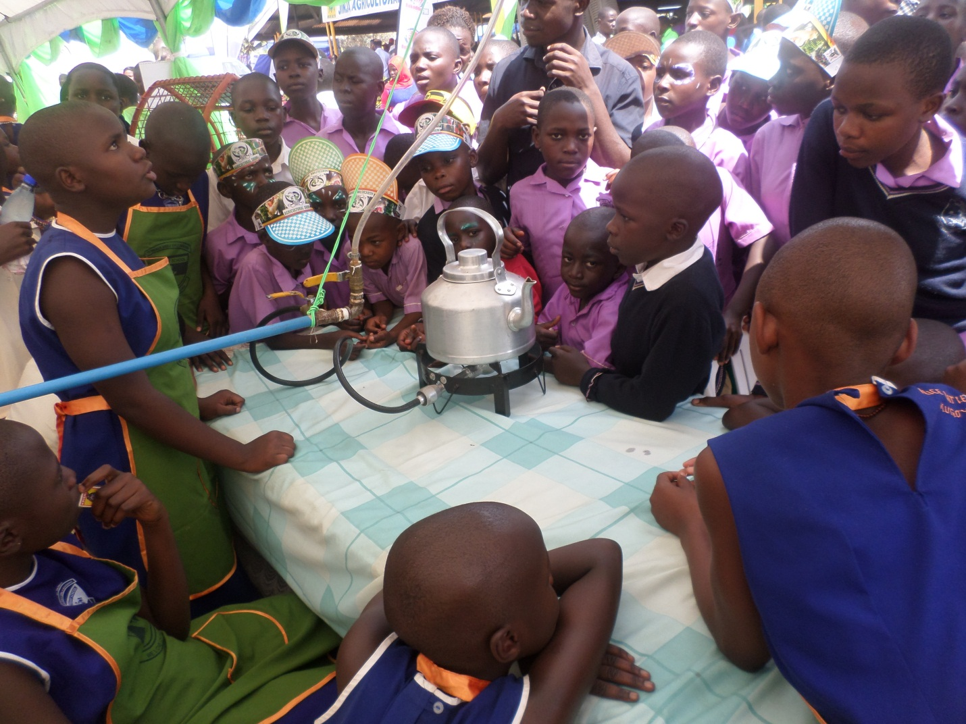
Biogas Exhibition by P5 Pupils – St. Patrick Kigulu Girls P/S

Slide 11
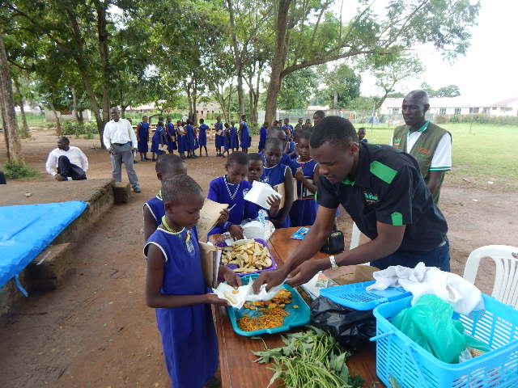
Influencing Nutrition Through School Partnerships

Slide 12
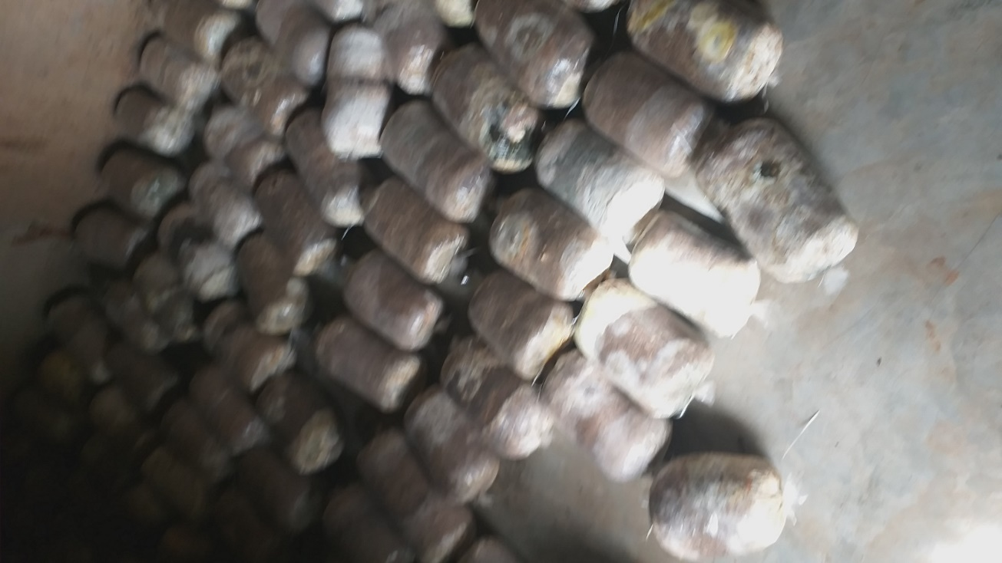
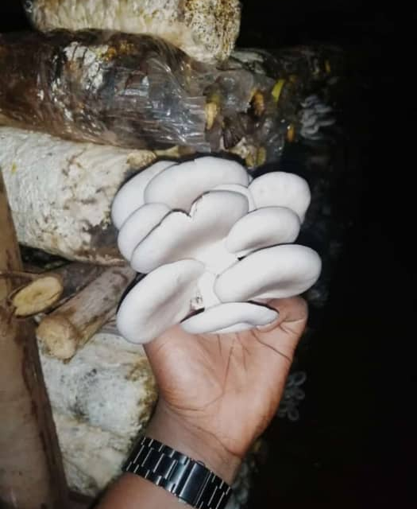
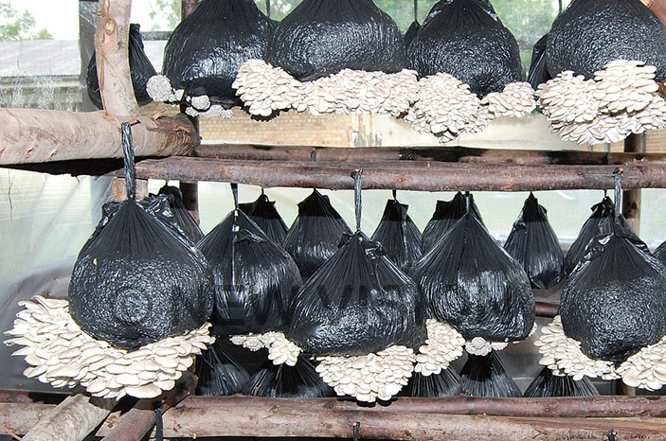
Mushroom Growing

Slide 13
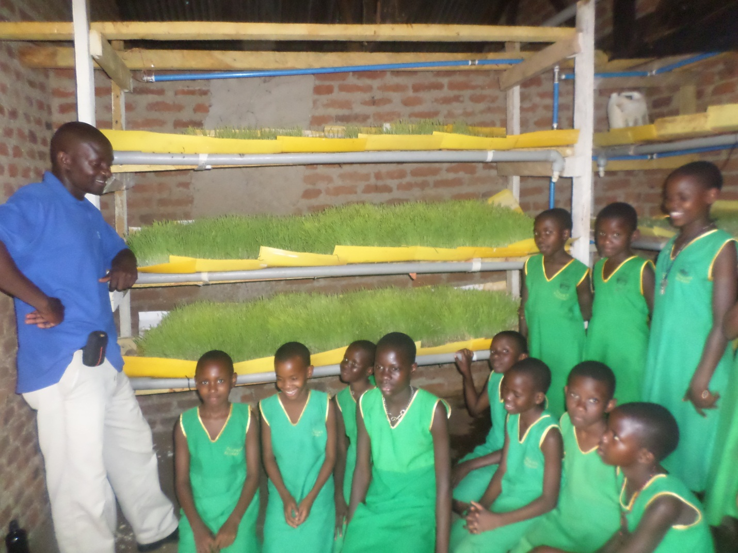
DIY Hydroponics Fodder

Slide 14
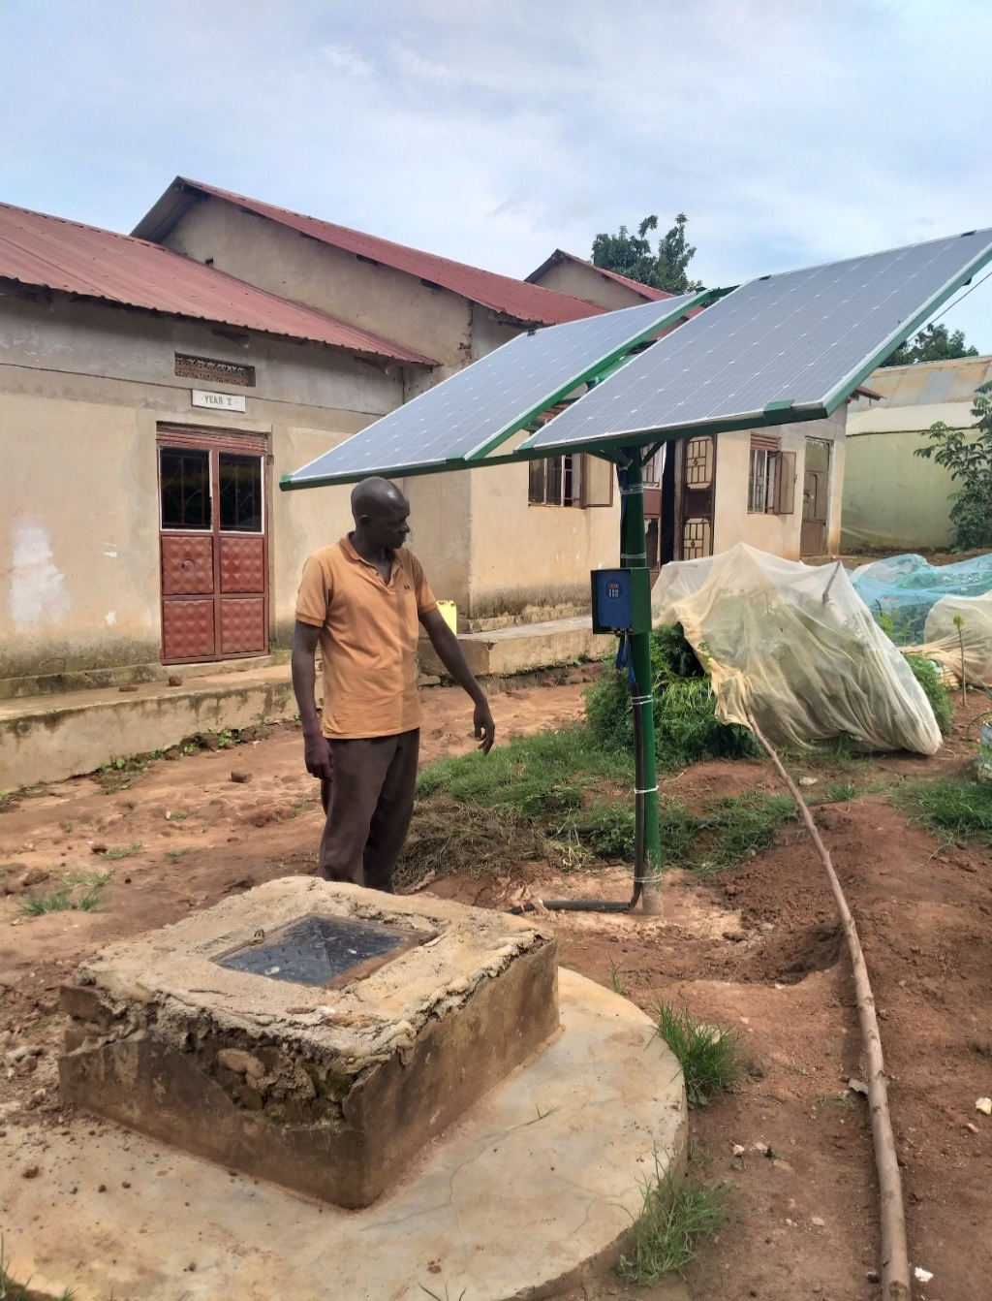
Solar Powered Irrigation System

Slide 15
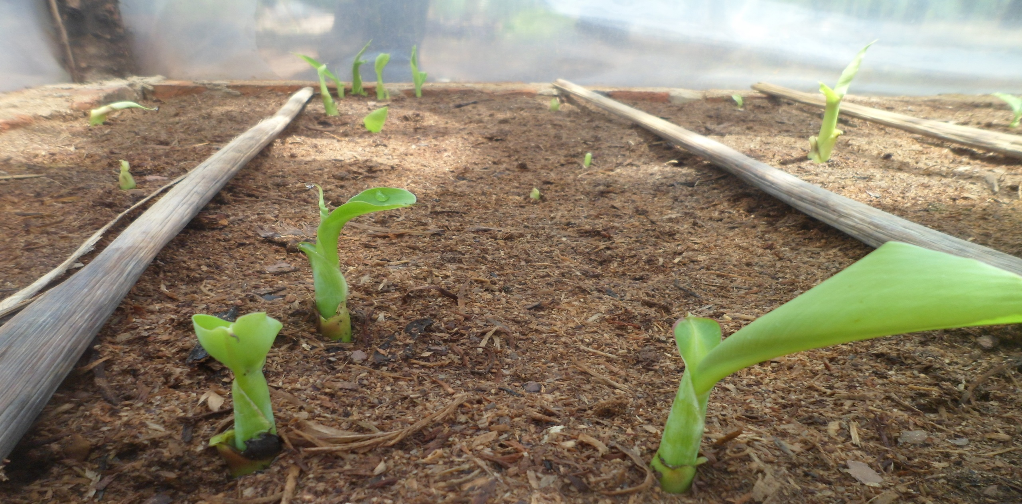
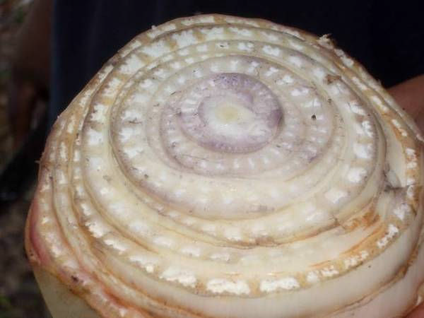
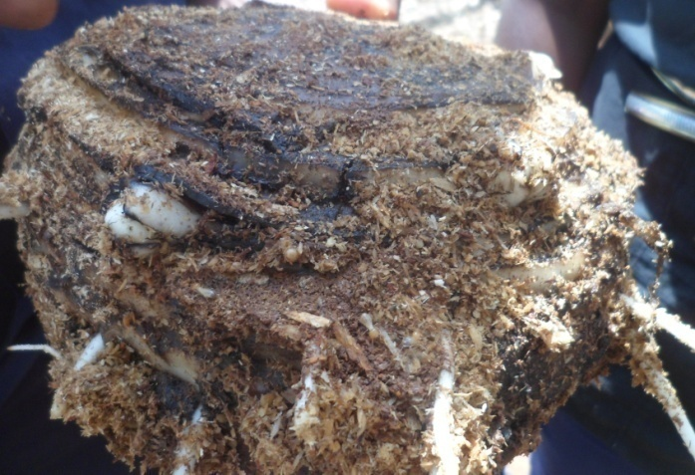
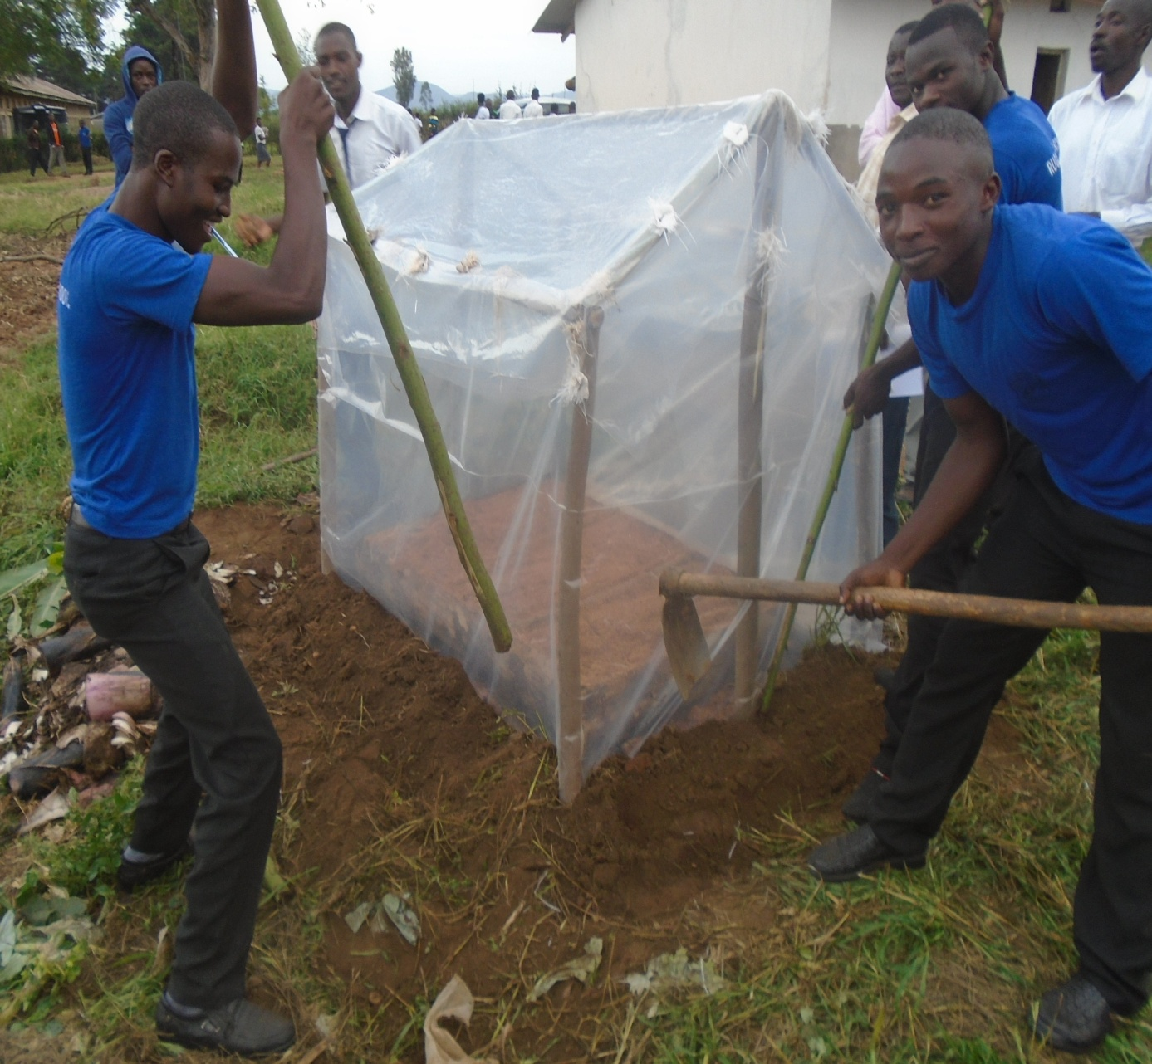
Banana Macro Propagation

Slide 16
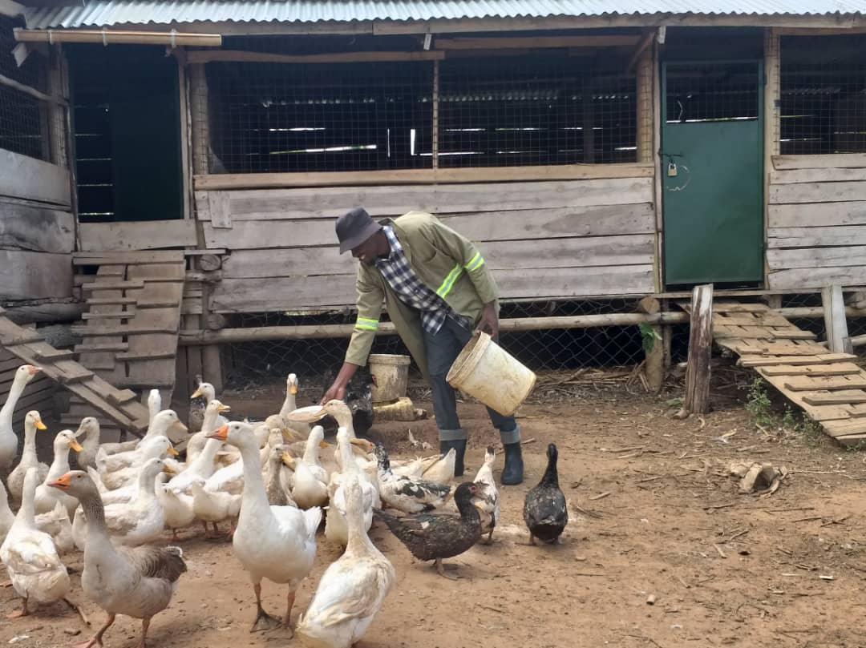
Rabbit & Geese Farming

Slide 17
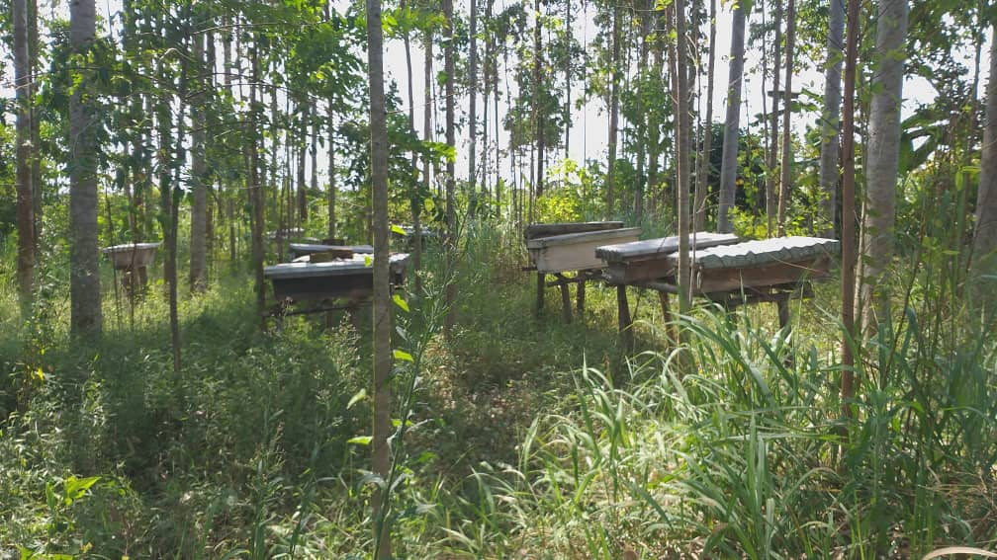
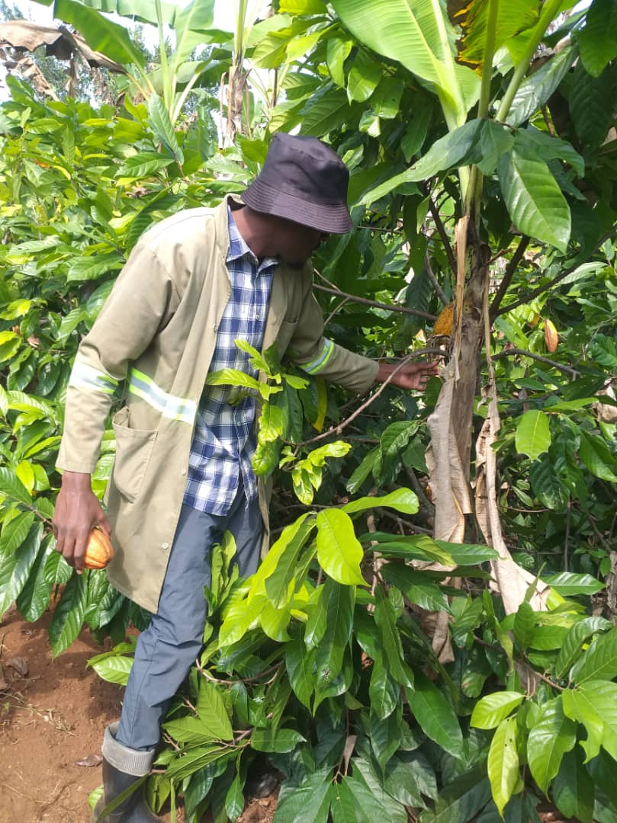
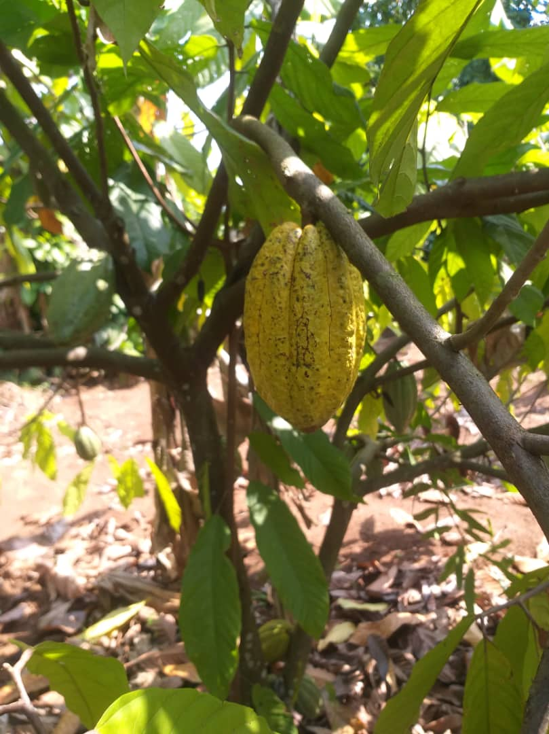
Apiary & Cocoa Production

Slide 18
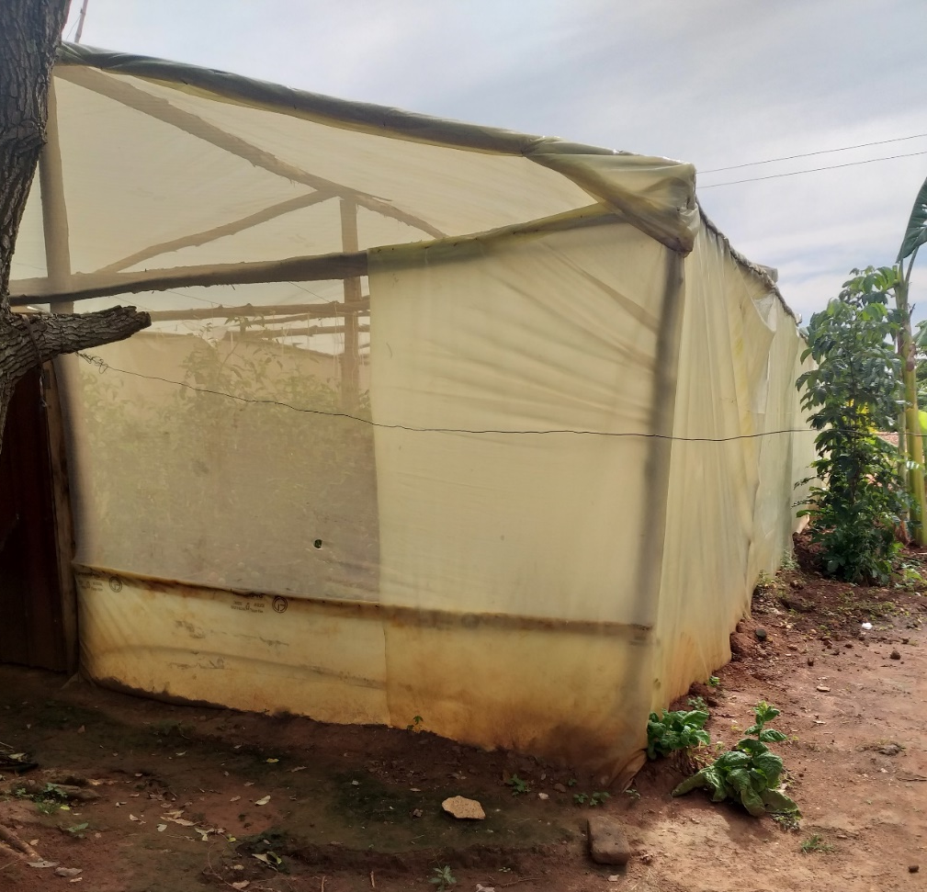
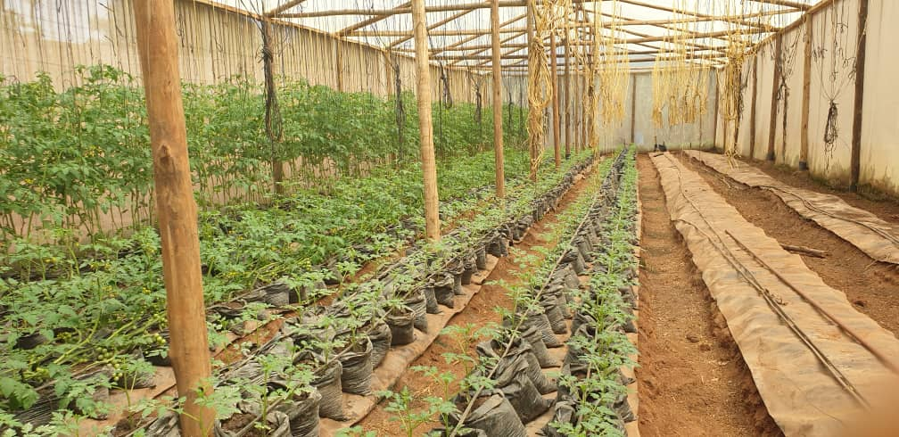
Green House Management

Slide 19
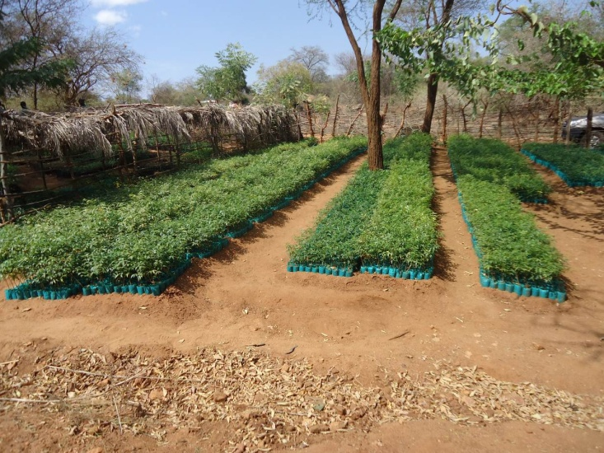
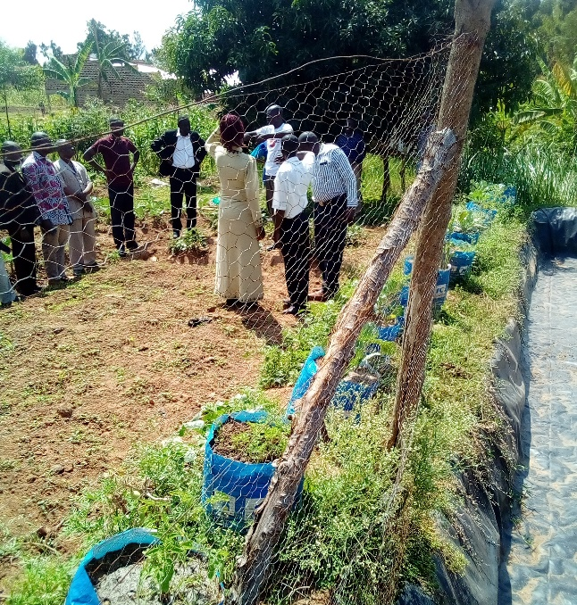
Education and Agri-Tourism Services
FAME provides Agri-Tourism services;
Solar powered Irrigation system
Biogas system
Mushroom production and processing
Macro propagation (Banana Multiplication)
Apiary
Piggery & geese keeping
Green house Management
DIY Hydroponics Fodder system
Fish farming, management, ponds and hatchery
Cocoa production
Rabbitry
Horticulture
Kitchen gardens
Poultry (ducks and ducklings)
215 Km
200 Km
150 Km

Slide 20
Challenges
Community response
Low enrollment
Transport (motorcycle/Pickup)
Limited qualified staff (recruitment)
Tools and equipments to use (water pump and tank, tailoring machines, carpentry tools etc)

Slide 21
Future plans
Set up a banana plantation(13200 stems)
Set a forest (atleast10 acres)
Increase our enrolment
Set up classroom block
Buy a motorcycle and pickup
Solicit for funds and support.

Slide 22
Location and Contacts
Kasugu Cell, Mayuge Town Council, Mayuge District Uganda Africa
Telephone:
Germany +4915736263099
Uganda +256771487749
E-mail: fameinstitute77@gmail.com

